Slide 1



CN6000
Final Year Project 2025/26
Topic 2
The Project Proposal and Literature Review

Slide 2
Lecture Content
Quick review:
The project proposal
Research/Project Aim
Research/Project Objectives
Proposal approval process
Supervisors
Project Planning
Time Management

Slide 3
Project Proposal
This should describe the aim of your project (the what) and the rationale (the why).
Please use the template available via Moodle
Look at the examples in the study guide as an indicator of the level of detail required
Deadline on Moodle:
29th Oct 2025 (Final Proposal)

Slide 4
Identifying a Good Topic:
Have you selected your topic already?
If not, did you not check the “Supervisor’s expertise’ page to get ideas?
Use the breakout study space this evening to meet each other and brainstorm ideas.
Email them to your choice of supervisor and ask them to select what they prefer.

Slide 5
Brief explanation of Theoretical Research
Stage 2: Research Methodology
You have a choice:
Quantitative
Qualitative
Mix of both
Methodological choices
Qualitative?
Quantitative?
Mixed?

Slide 6

Brief explanation of Theoretical Research
Stage 2: Research Methodology
Quantitative: Usually involves using a survey to gather opinions, views, or data.
Example: See if people like a new software idea? What a group of employee think of a new data dashboard? Analysis of data use of a particular app?
Usually, we expect it to collect data from 50 to 100 respondent / Published datasets.
This Photo by Unknown Author is licensed under CC BY-NC

Slide 7


Brief explanation of Theoretical Research
Stage 2: Research Methodology
Qualitative: This usually involves interviews or focus groups with a selected few people who are experts or relevant to your study.
Example: Interview sample managers of the software to understand their needs. Arrange a focus group of users to understand their dashboard needs. Study feedback reported on given apps of similar topics.
Usually, we expect it to collect data from 5 to 10 respondents.
This Photo by Unknown Author is licensed under CC BY-NC
This Photo by Unknown Author is licensed under CC BY

Slide 8
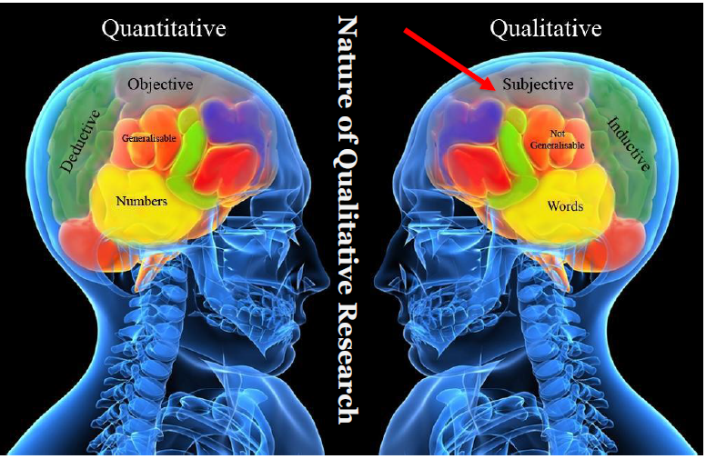
Qualitative vs. Quantitative

Slide 9
Very Important
How to rewrite aim and objectives for your research project!

Slide 10
Aim and Objectives:
Aim is usually one single sentence that summarises the purpose of the project. What are you hoping to achieve? Let us see some examples:
Design and develop software that better manages stocks at an SME using mobile scanners.
Create an interactive dashboard to manage stock market predictions using a live data stream.
Implement a local health app system for borough of Newham.
Notice: Aim is about ‘What’ you want to do and not ‘How’.

Slide 11
Aim and Objectives:
Objectives has to be multiple lines in bullet points. Minimum of four but as much as eight points. Have to outline how you will do the project.
Strongly recommended to have four elements:
Theoretical Research
Field Research: Qualitative verse quantitative
Practical: application and testing
Reflection: Going forward

Slide 12
Aim and Objectives:
Aim: Design and develop a software that better manages stocks at an SME using mobile scanners.

Slide 13
Aim and Objectives:
Aim: Design and develop a software that better manages stocks at an SME using mobile scanners.
Objectives:
By the end of this project, I will be able:
To research different software related to stock management.
To research the literature on the design relating to stock management using mobile apps.
To conduct a survey of SME business on use of mobile app for stock management.
To use quantitative analysis on the survey findings.
To design and implement a demo stock management database linked to app frontend.
To test app for functionality and design.
To reflect on the outcomes, challenges, and suggest future research in this field.
Theoretical Research
Field Research: Qualitative verse quantitative
Practical: application and testing
Reflection: Going forward

Slide 14
Aim and Objectives:
Aim: Create an interactive dashboard to managing stock market predictions using live data stream.

Slide 15
Aim and Objectives:
Aim: Create an interactive dashboard to manage stock market predictions using a live data stream.
Objectives:
By the end of this project, I will be able:
To research different stock market prediction formulas in the literature.
To research approaches and risks to live data stream connectivity.
To design and implement a demo stock market dashboard system.
To test system for functionality and report on accuracy.
To conduct interview with stock market investors on the design and functionality of the software.
To use qualitative data analysis tools and identify themes for improvements.
To reflect on the outcomes, challenges, and suggest further development of the software.
Theoretical Research
Field Research: Qualitative verse quantitative
Practical: application and testing
Reflection: Going forward

Slide 16
Aim and Objectives:
Aim: Implement a local health app system for borough of Newham.

Slide 17
Aim and Objectives:
Aim: Implement a local health app system for the borough of Newham.
Objectives:
By the end of this project, I will be able:
To research current literature of use of health apps and their impact.
To conduct research of current health facilities and activities in Newham.
To use qualitative data tools to identify themes and requirements using focus groups.
To design and implement a demo health app for Newham.
To test the app for functionality and report on accuracy.
To reflect on the outcomes, challenges, and suggest further development of the app.
Theoretical Research
Field Research: Qualitative verse quantitative
Practical: application and testing
Reflection: Going forward

Slide 18

Supervisors
Supervisors are responsible for providing students with help and guidance throughout their project assessment.
The responsibilities of the supervisor include:
1. To give guidance about the nature of the project enquiry and the standard of work to be expected.
2. To advise students about the planning of the project and to discuss a timetable.
3. To encourage students to acquire and maintain familiarity with relevant developments in their subject.
4. To give advice about the quality of the work and areas to improve.

Slide 19
Supervisors
The responsibilities of the supervisor include:
5. To maintain contact through project meetings. The frequency and nature of these sessions will vary depending on the characteristics of the topic and the requirements of the discipline.
6. To be accessible to the student at other appropriate and reasonable times when advice may be needed.
7. To give advice on the preparation of a dissertation and advise the student if the standard of English is inadequate.
9. To read a draft section(s) of the student’s dissertation once only. Further readings are at the discretion of the dissertation supervisor/tutor.

Slide 20
Supervisors
The responsibilities of the supervisor do NOT include:
To teach you how to do the project.
To correct your writing or your language.
To chase you or beg you to come to a meeting.
To promise you or tell you what grade you will get or are likely to get.

Slide 21
Break 1:
Have you selected your topic?
Have you selected your supervisor yet?
Any questions about your role with your supervisor?
Do you know when the deadline to select your supervisor?

Slide 22
Project Planning
You need to start early in planning your project.
By now, you should have a clear idea of your project’s overall purpose (ie your aim) and the means by which you will achieve your overall purpose (ie your objectives)

Slide 23
Project Planning
You need to start early in planning your project.
By now, you should have a clear idea of your project’s overall purpose (ie your aim) and the means by which you will achieve your overall purpose (ie your objectives)
Your objectives will help you plan your project!
Without your project objectives finalised, you cannot start your project planning!!

Slide 24
Project Planning
You need to start early in planning your project.
By now, you should have a clear idea of your project’s overall purpose (ie your aim) and the means by which you will achieve your overall purpose (ie your objectives)
Your objectives will help you plan your project!
Without your project objectives finalised, you cannot start your project planning!!
Project objectives assist you by
identifying the work you need to perform,
clarifying the order in which you should tackle the tasks.
Set the milestones of your project.

Slide 25
On Project Planning (cont.)
Project planning can be modeled by a series of six tools:
Work breakdown,
Time estimates,
Milestone identification,
Activity sequencing,
Scheduling,
Re-planning.
You don’t need to use all of them, but you should try to at least use three of them.

Slide 26
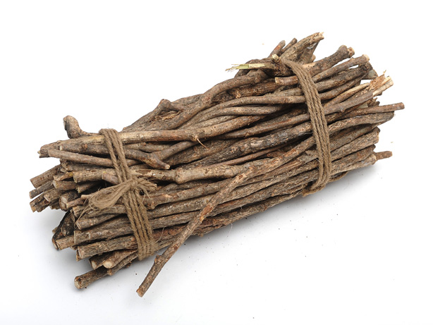
Work Breakdown: Break this bundle in half!
The principle of WB is that taking a big problem on in one go is difficult.

Slide 27

Work Breakdown: Separate the bundle into individual straws
Divide and conquer!

Slide 28
Work Breakdown
Breaking your work down into smaller and more achievable tasks. Start with the aim and then identify the objectives (approx. 6)
To achieve these objectives, you need to break them into lower levels until you reach manageable tasks.
After this first round, you may find that some tasks can be broken down further. However, at some point, you need to stop decomposing.
For example, it is not generally useful to identify tasks which will take you a few weeks but more those that would take a day or two to complete.
As you decompose your project, you should ensure that tasks at all levels are discrete and that a task in one part of your plan is not repeated elsewhere.
If this happens, you may be duplicating effort unnecessarily.

Slide 29
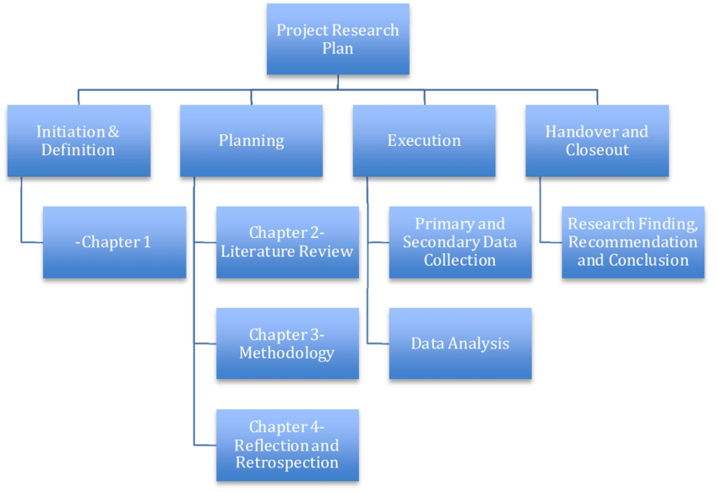
Work Breakdown (cont.)
For your own records, you may want to represent the overall project breakdown as a layered diagram. The picture below represents an artificial neural network (ANN) project.

Slide 30
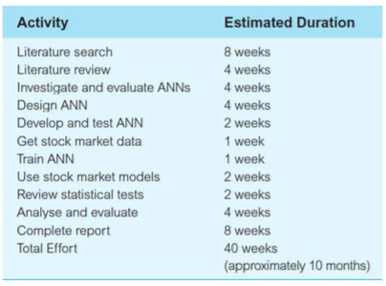
Time Estimates
Since your project is broken into a number of tasks it is much easier to estimate how long it will take to complete.
In order to do so, proceed upwards; i.e. from the bottom (lowest tasks), estimating a duration for each of the lowest level tasks.

Slide 31

Time Estimates (cont.)
Once you have created the table, you may find that you have aimed to do too much in the time available and need to reduce what you intend to achieve.
Avoid tight margins. Over the course of six months, it is likely that some unexpected events will occur (whether they are related to your project or not).
If your margins are too tight and do not allow any flexibility, then you might not be able to complete your project on time.

Slide 32
Identify Milestones:
Significant steps towards the completion of the project,
Evaluate the current progress.
These enable you to assess, at the earliest opportunity, how you are progressing against your planned schedule and to take timely action.
To identify milestones, you should focus on your project’s work breakdown structure.
A common approach is to use some (if not all) of your project’s objectives as milestones since they are the key components for your project to be successful.

Slide 33
Identify Milestones (cont.)
The number of milestones that you will identify for your project will vary depending on the project’s size and complexity.
Example:
final proposal,
Initial literature review,
practical design,
implementation,
testing,
critical analysis.
Writing the document
One milestone you must always identify is the project’s completion.

Slide 34
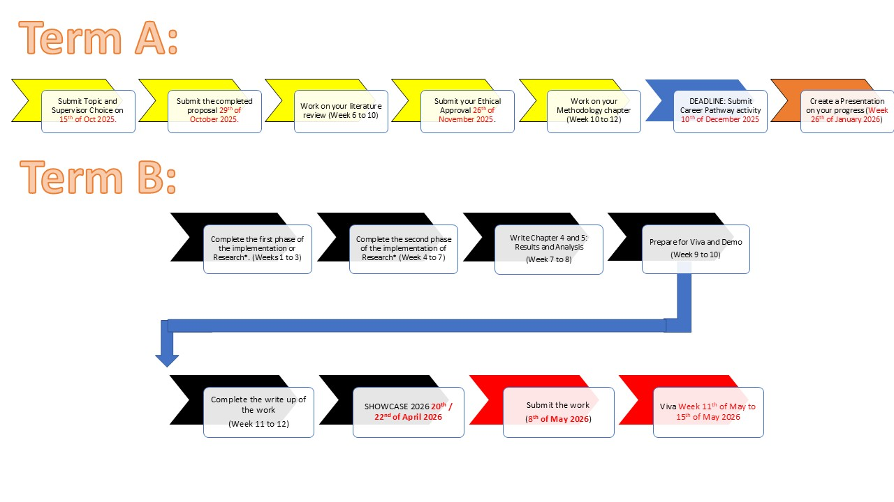
Identify Milestones (cont.)

Slide 35
Scheduling
Gantt charts are similar to activity networks in that they attempt to represent a project in diagrammatical form.
However, unlike activity networks, they do not show the relationships between tasks, but they do explicitly show the durations of activities and identify instances when tasks are performed simultaneously.
represent a project’s activities as rectangles or nodes, and milestones by diamonds (like activity networks),
the size (length) of an activity’s node represents the duration of that activity.

Slide 36
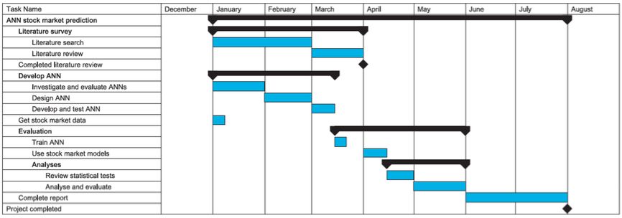
Scheduling (cont.)
A Gantt Chart created using Microsoft Project
(Dawson)

Slide 37
Scheduling (cont.)
To draw your Gantt chart, you will need a project planning tool
You are free to choose your own tool provided that it creates plans that can be shared with your supervisor via a browser.
We recommend the use of Trello (www.trello.com)
It’s web-based
There’s a mobile app
It’s free
It supports collaborative working
Watch the video on Moodle which shows you how to integrate the TeamGantt powerup into Trello

Slide 38
Break 2:
Which of these tools are you going to use to plan your project?
All plans are just written on paper. What is key to the success of a plan?

Slide 39
Time Management: Is this you?

Slide 40
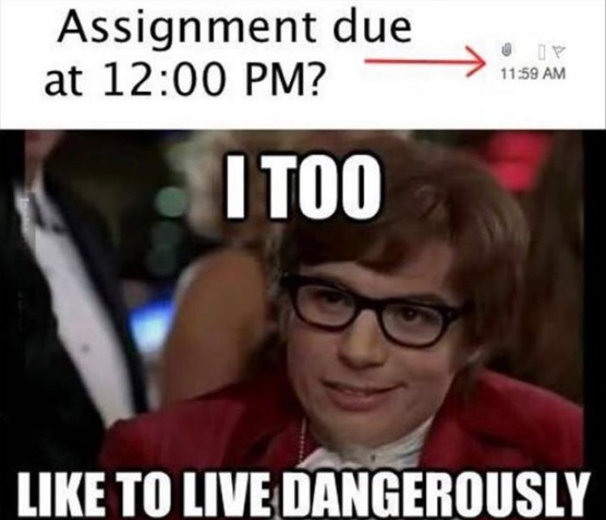
Time Management: Is this you?

Slide 41
Time Management: Is this you?

Slide 42

Time Management: Is this you?

Slide 43
Time Management:
Work & Career

Slide 44
Time Management:
Work & Career
Family & Friends

Slide 45
Time Management:
Work & Career
Family & Friends
YOU!!!

Slide 46
Time Management:
Workaholic?
Work & Career
Family & Friends
YOU!!!

Slide 47
Time Management:
Family oriented?
Family & Friends
Work & Career
YOU!!!

Slide 48
Time Management:
Selfish?
YOU!!!
Work & Career
Family & Friends

Slide 49
Time Management:
Have a balance!
Work & Career
Family & Friends
YOU!!!

Slide 50
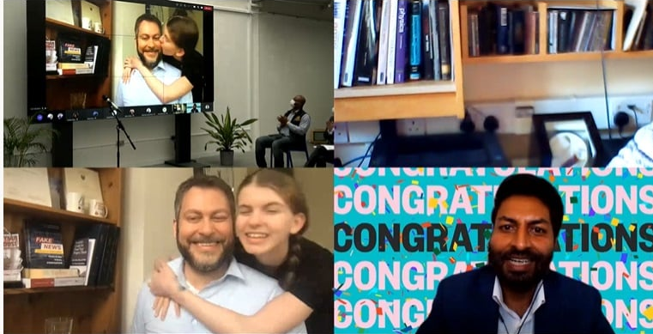
Time Management:
Have a balance!
Work & Career
Family & Friends
YOU!!!

Slide 51
Time Management:
Have a balance!
Work & Career
Family & Friends
YOU!!!

Slide 52
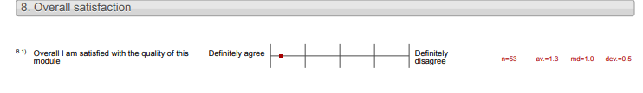
Time Management:
Have a balance!
Work & Career
Family & Friends
YOU!!!

Slide 53
Time Management:
Have a balance!
Work & Career
Family & Friends
YOU!!!

Slide 54
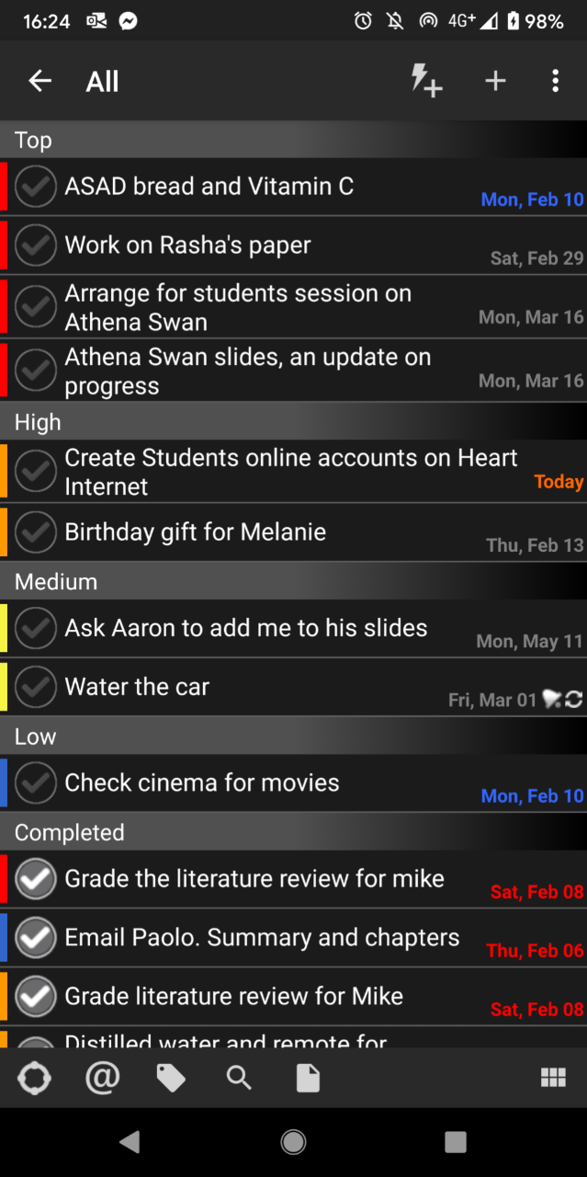
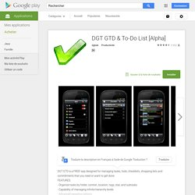
DGT GTD

Slide 55

David Allen’s book:
Getting Things Done:
The art of Stress free productivity – recommended book to read – why?
Time management is the source of problems for most people.
Managing university commitments, work commitments, family commitments, and personal commitments.
Get this right and you will find you are able to manage yourself much better.
His method is tried and tested by many including myself!!
55

Slide 56
Break 3:
What approach will you take to manage your time this year?
Did you any of you continue the GTD approach from year one?

Slide 57
Learning Objectives
Upon completion of this topic, you should be able to:
Explain the significance of the project proposal.
Distinguish between the initial and final proposal.
Start writing a final proposal.
Identify the difference between aims and objectives.
Write clear and comprehensive objectives.

Slide 58
Directed Reading
Safieddine, F. (2021) Student’s Guide to Final Year Project Thesis: BSc, MSc, MA, and MBA. 4th Edition. CreateSpace, New York, USA. Pages 1 – 18.
Dawson, C. W. (2015) Projects in Computing and Information Systems: A Student’s Guide. 3rd ed. Harlow, Essex: Pearson Education, Chaps. 3 & 5

